Slide 1
Software Construction
Abstract class, Data Types & Functions

Slide 2
Abstract Class
&
Function

Slide 3
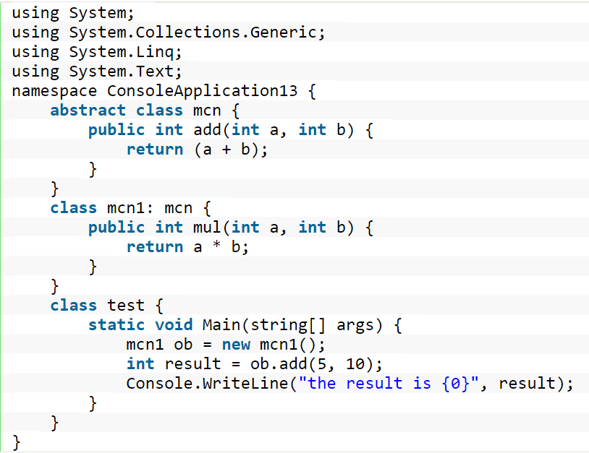
Abstract Class
If a class is defined as abstract, then we can't create an instance of that class. By the creation of the derived class object where an abstract class is inherited from, we can call the method of the abstract class.
In the above program we can call the method of the abstract class mcn with the help of an object of the mcn1 class which inherits from the class mcn.

Slide 4
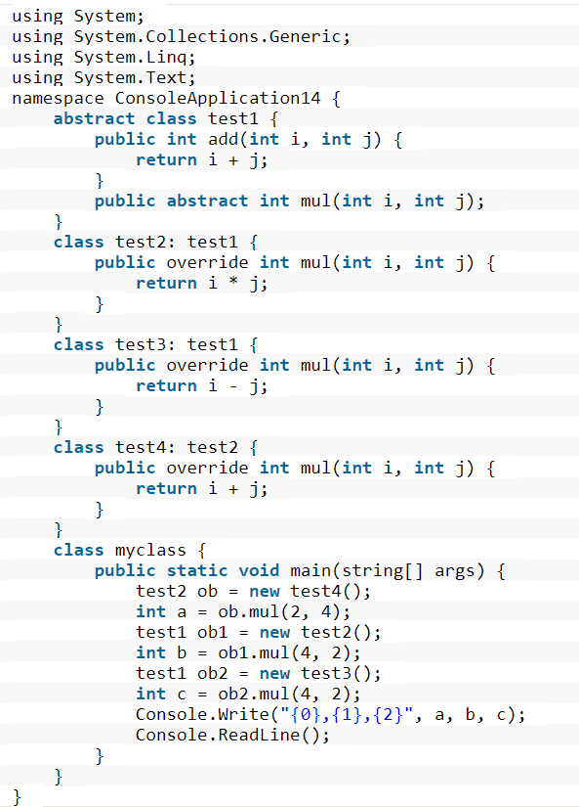
Abstract Methods
An Abstract method is a method without a body. The implementation of an abstract method is done by a derived class. When the derived class inherits the abstract method from the abstract class, it must override the abstract method. This requirement is enforced at compile time and is also called dynamic polymorphism.
In the above program, one method i.e. mul can perform various functions depending on the value passed as parameters by creating an object of various classes which inherit other classes. Hence we can achieve dynamic polymorphism with the help of an abstract method.

Slide 5
Abstract Data Types

Slide 6
Abstract Data Types (ADTs)
Abstract data types are an instance of a general principle in software engineering, which goes by many names with slightly different shades of meaning. Here are some of the names that are used for this idea:
Abstraction. Omitting or hiding low-level details with a simpler, higher-level idea.
Modularity. Dividing a system into components or modules, each of which can be designed, implemented, tested, reasoned about, and reused separately from the rest of the system.
Encapsulation. Building walls around a module (a hard shell or capsule) so that the module is responsible for its own internal behavior, and bugs in other parts of the system can’t damage its integrity.
Information hiding. Hiding details of a module’s implementation from the rest of the system, so that those details can be changed later without changing the rest of the system.
Separation of concerns. Making a feature (or “concern”) the responsibility of a single module, rather than spreading it across multiple modules.

Slide 7
Cont.
As a software engineer, you should know these terms, because you will run into them frequently. The fundamental purpose of all of these ideas is to help achieve the three important properties that we care about: safety from bugs, ease of understanding, and readiness for change
“ADTs are the entities that are definitions of data and operations but do not have implementation details.”
In the early days of computing, users could define their own procedures: that’s how large programs were built
A major advance in software development was the idea of abstract types: that one could design a programming language to allow user-defined types, too.

Slide 8
User Defined Type
The key idea of data abstraction is that a type is characterized by the operations you can perform on it. A number is something you can add and multiply; a string is something you can concatenate and take substrings of; a boolean is something you can negate, and so on.
In a sense, users could already define their own types in early programming languages: you could create a record type date, for example, with integer fields for day, month, and year. But what made abstract types new and different was the focus on operations: the user of the type would not need to worry about how its values were actually stored, in the same way that a programmer can ignore how the compiler actually stores integers. All that matters is the operations.
An abstract data type (not to be confused with an abstract class) is a model for building a class of data structures which have similar behavior. Abstract data types include stacks, queues, lists and sets. The abstract data type specifies what operations should be provided by an implementation of that data type without actually implementing it.
For example, a stack should have push, pop and top operations and a queue should have enqueue and dequeue operations. The methods which implement these operations do not necessarily need to have the same names.

Slide 9
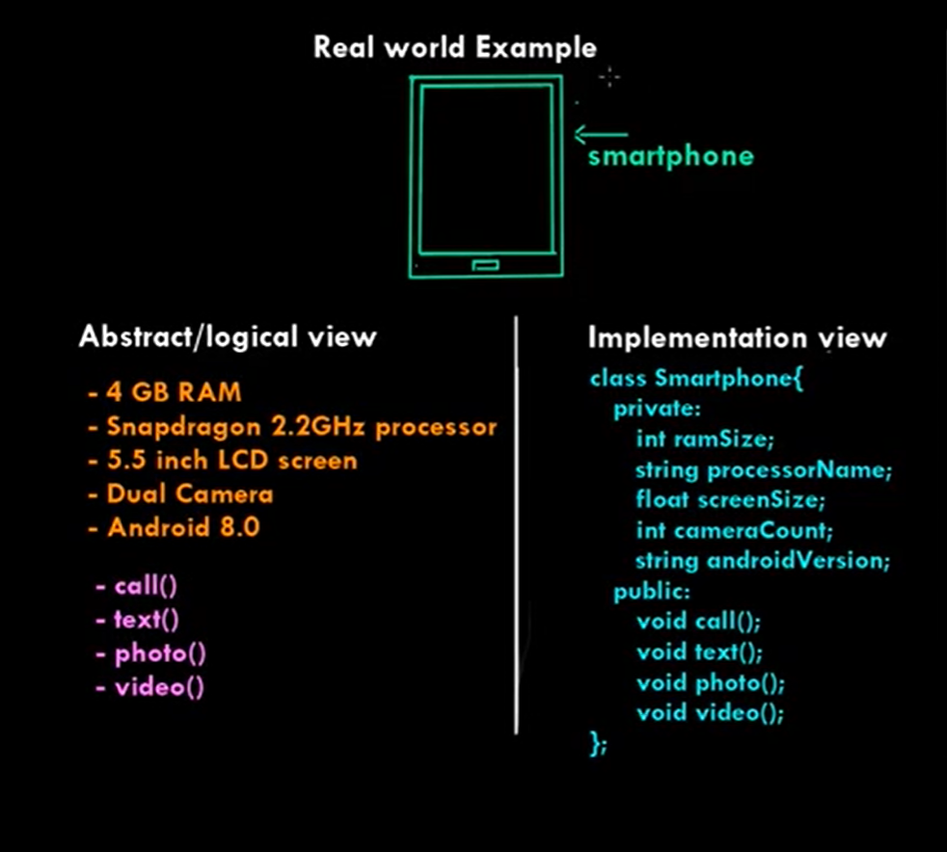
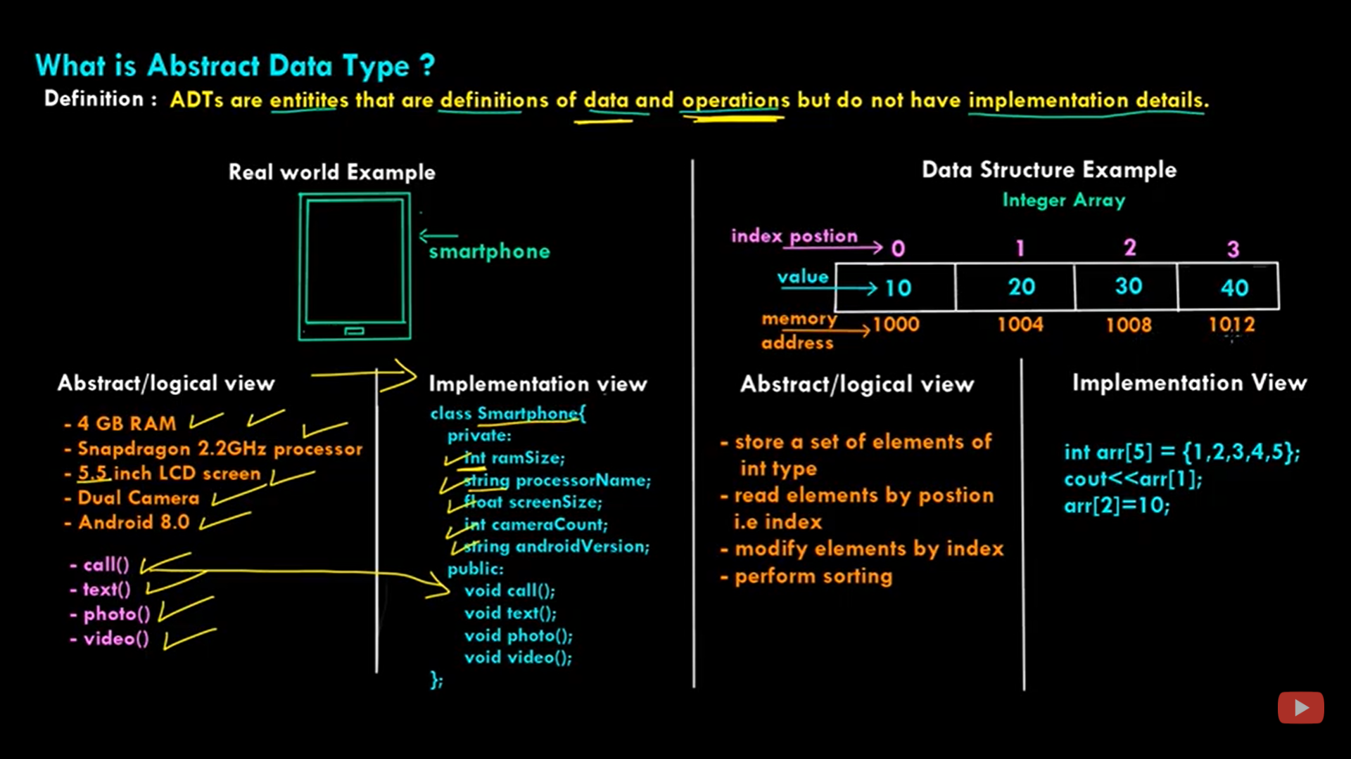
Notes:
Queue, finite state machine, floating and complex, vector and matrix data type

